Slide 1

Portfolio Optimization With Markowitz Model by mean-variance optimization
Raman’s Champions
Ankit Sharma
Vishnu Satish
Augustine Baby
Nishit Pravinbhai Popat
Sri Venkatesh Subramaniam

Slide 2

What is a financial portfolio?
Simply put, it's a collection of financial assets. It could contain a number of financial products like stocks, bonds, cash and cash equivalents, alternative investments, even life insurance, property or other assets.

Slide 3

Why Optimize a Portfolio?
Portfolio optimization maximizes returns and minimizes risk.
Diversification benefits reduce the impact of individual asset performance.
Finding the optimal balance between risk and reward.
Efficient Frontier: Maximum return for a given level of risk.
Ongoing process to adapt to changing market conditions.
Vital for institutional investors to achieve financial goals.
Involves quantitative techniques and risk management.

Slide 4
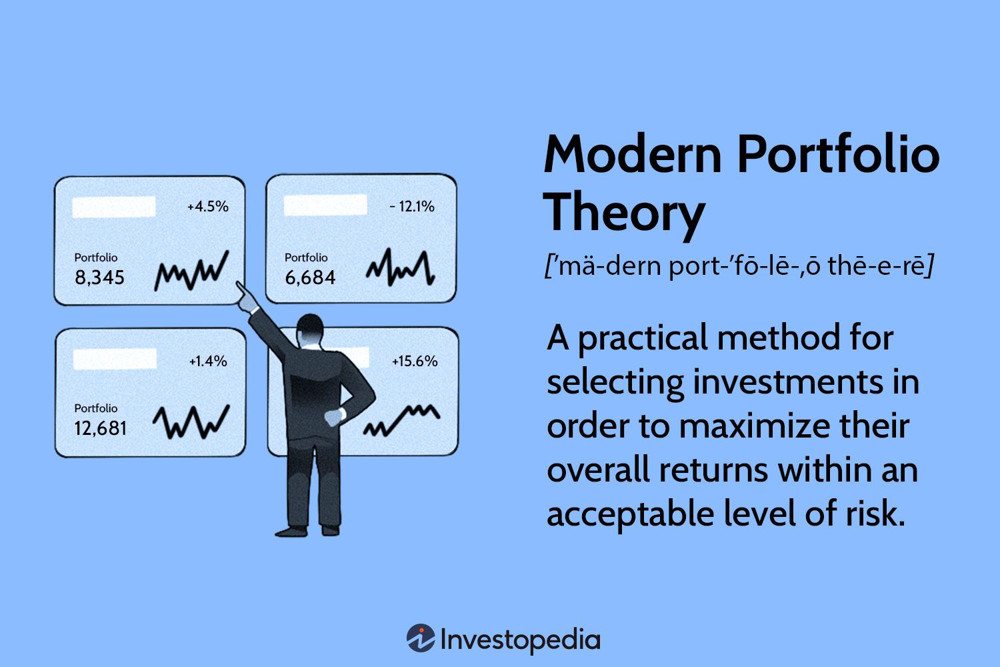
Modern Portfolio Theory (Markowitz Model)
The Harry Markowitz Model states: stocks in a portfolio can either be of low risk and low returns or high risk and high returns. Optimizing both can help maximize an investor's total portfolio return.
1990 Nobel Prize Recipient in Economic Sciences

Slide 5
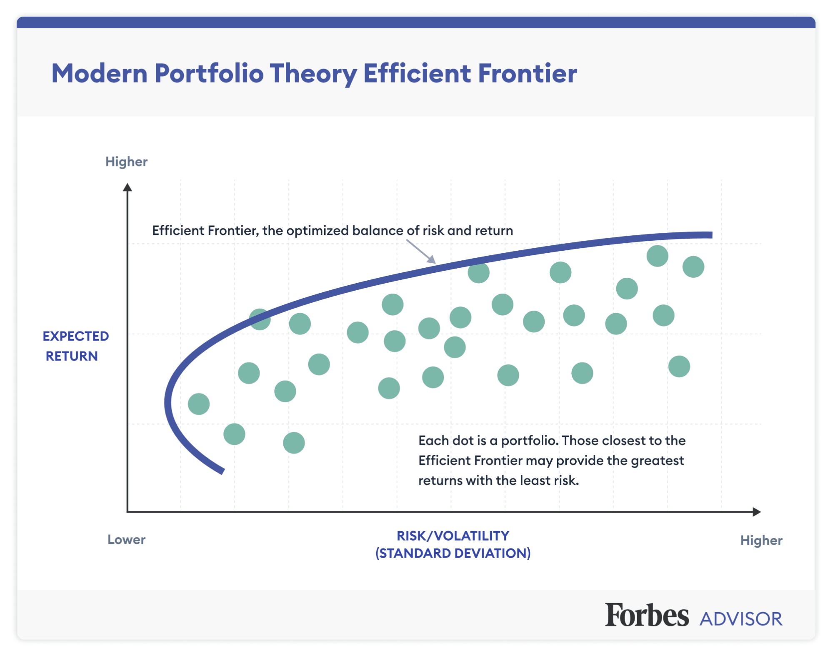
Finding the “Efficient Frontier”
Best Risk-Return Ratio

Slide 6
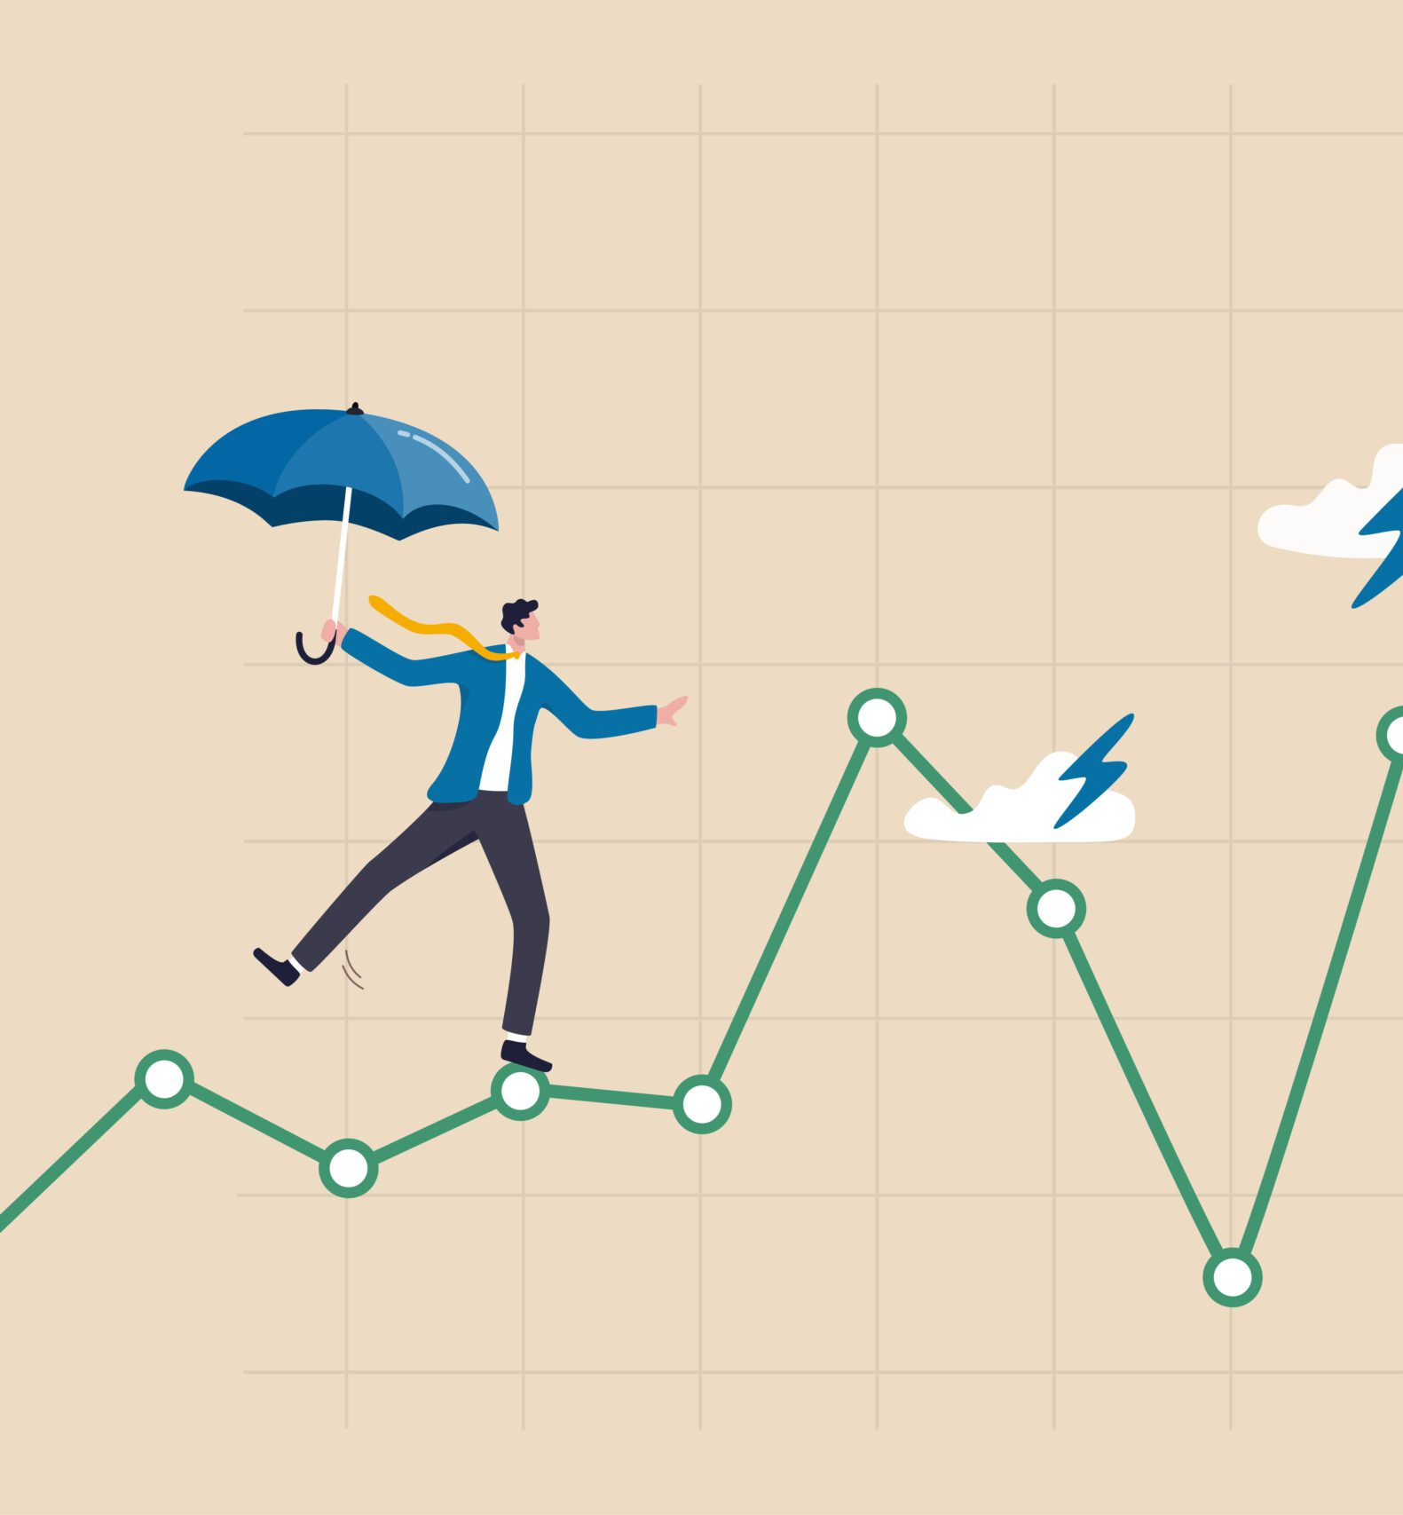
Risk is Varinace / Standard Deviation
Risk in the stock market is quantified using Variance and Standard Deviation.
Variance
Standard Deviation
High Variance/Standard Deviation

Slide 7

Sharpe Ratio
The Sharpe Ratio measures risk-adjusted returns.
Formula: (Portfolio Return - Risk-Free Rate) / Portfolio Standard Deviation
Higher Sharpe Ratio = Better risk-adjusted returns.
Helps compare portfolios and understand risk-return trade-offs.

Slide 8
Thank You

